Slide 1

Notes:
Hello Amy & Addy! We are to present some properties to invest in....

Slide 2
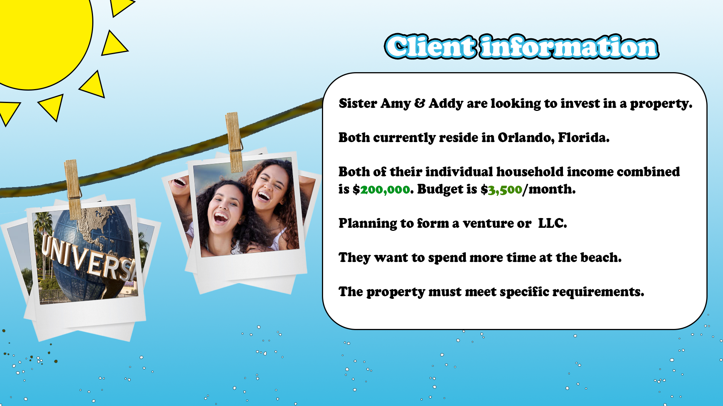
Notes:
A brief client overview:
1.Sisters Amy and Addy are looking to invest in a property.
2 Both of their individual incomes combined is $200,000 and they set a budget of $3,500.
3. planning to form a venture or LLC
4. They want o spend more time at the beach
5. this property need to meet their requirements

Slide 3
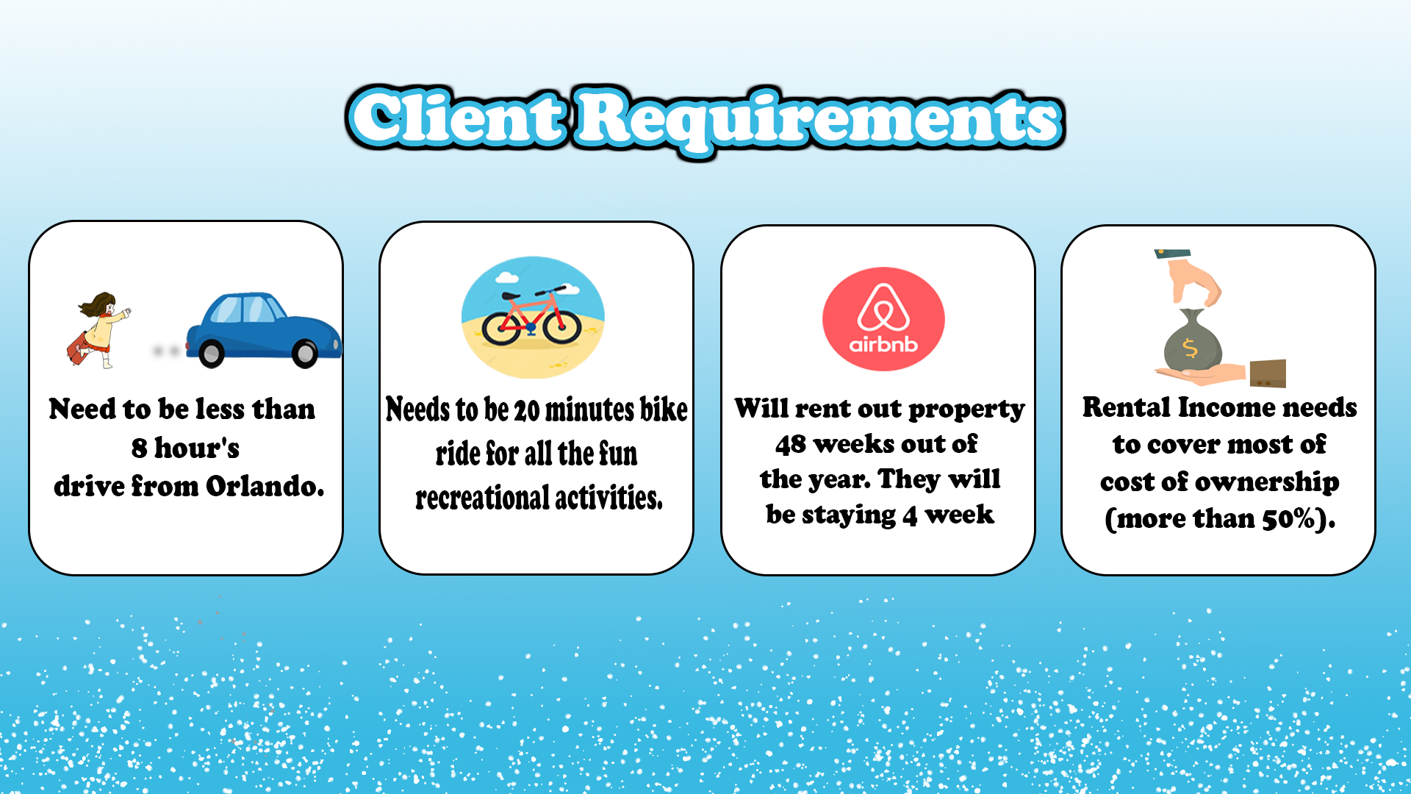
Notes:
Which is, The property needs to be:
less than 8 hours drive from their home.
20 minutes Bike ride for all the fun recreational activities.
They will be renting this property out 48 weeks out of the year.
Rental income needs to cover most of cost of ownership.

Slide 4

Meets all the superficial requirements:
Less than 4 hours driving from Orlando, Florida.
Multiple properties that are within a 20 minutes bike ride to the business district and the beach. Snorkeling is available.
Had access to a more dense & specific data set.
Notes:
Why Lauderdale blah:
-It meets all the superficial requirements:
-4hours drive from Orlando
-multiple properties available that are withing 20 mins bike ride to the business district and the beach.
& -The data set available was dense with information we needed.

Slide 5
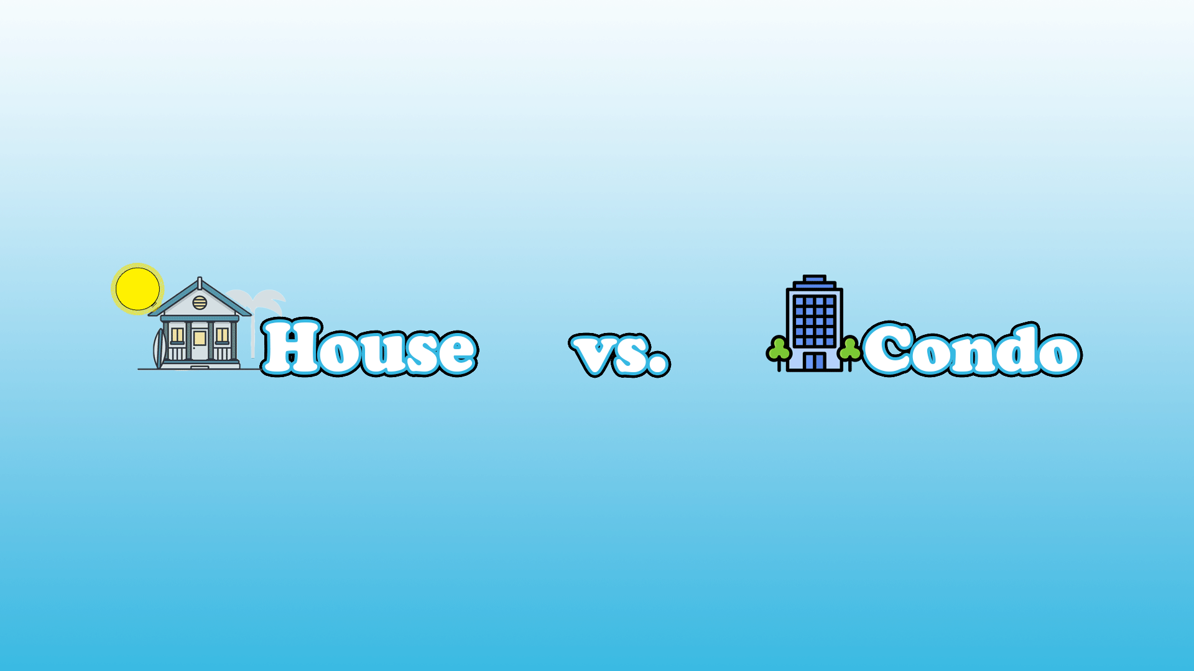
Notes:
Now, I will pass it over to my colleague Connor who will go over the home market analysis-

Slide 6

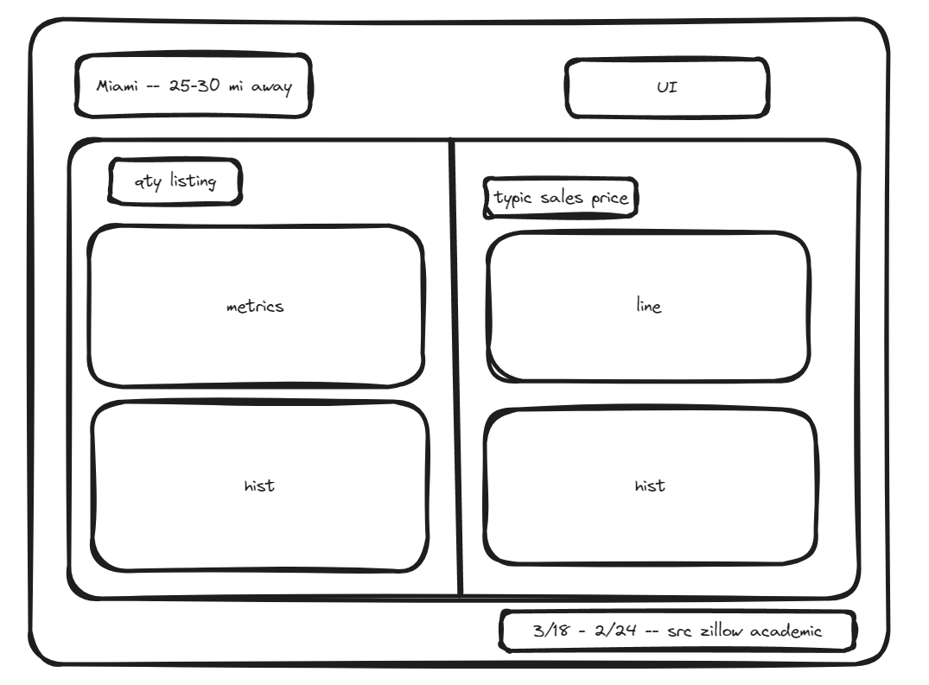
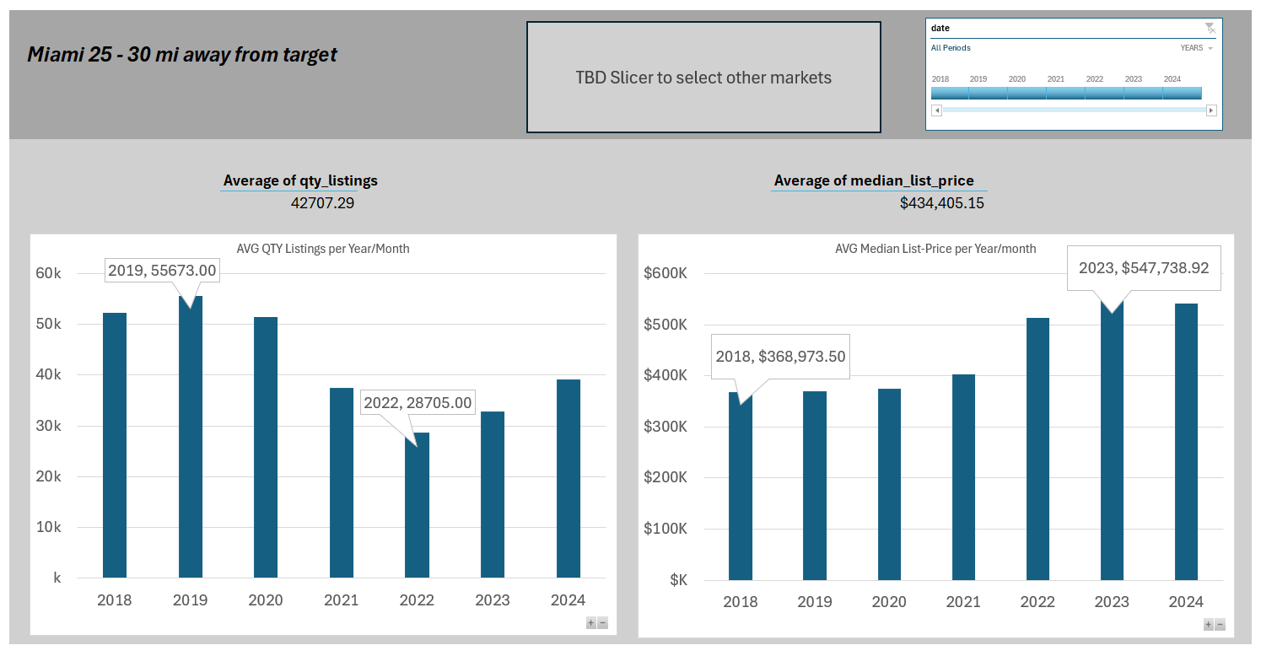
HOME MARKET ANALYSIS –
From mock up to work in progress
Notes:
Limits and assumptions
Currently with the market research we came into a little bit of a stumper, but we were able to make massive progress even though we have this issue.
Riff off of this
I ended up starting my work via searching for open and accessible data that could help with the housing market as per the ticketed request.
I found several leads but with the current budget of the assignment and timeline I found that this was not going to work.
In further iteration I would suggest a partnership with zillow group in order to access their pro API. I have requested access under the identity of an instructor, typically this gets a foot in the door.
there is a set of information on the housing market in th US that is highly aggregated but might be enough for the work that we are doing
https://www.zillow.com/research/data/
This is zillows extension for research and academic projects.
From here I looked into For-sale Listings. While I am not able to narrow into the FTLBTS area and look into their specific housing market per key search terms I am able to give a general sense of the market health.
I took all of the possible outputs for florida and made a map using google mymaps. From there I eyeballed what the closets areas were.
I then started some data work.
I took all of the information from the FOR-SALE LISTINGS endpoint for both the median list price smooth, all homes, mothly and the for-sale inventory smooth, all homes, mothly downloaded them independently. Saught out information that could be usable. Then I picked out information from just one close area

Slide 7

Mortgage Payment Calculation
Estimates:
-Home Value $547,150
-Down Payment $51,000 (11%)
-Interest Rate 7.77%
-30 Year Term
-Property Tax 1.52% or $8,426/year
-PMI: 0.5%
-Home Insurance $2,000/year
-Monthly HOA: $430
Annual Payment: $58,322.08
Notes:
51000

Slide 8
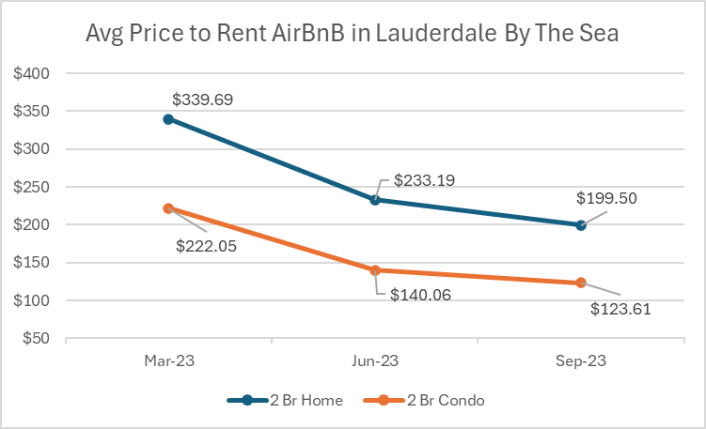
Seasonality is a factor
Average $95/night difference Mar-Sept
Demand likely increases further in winter

Slide 9
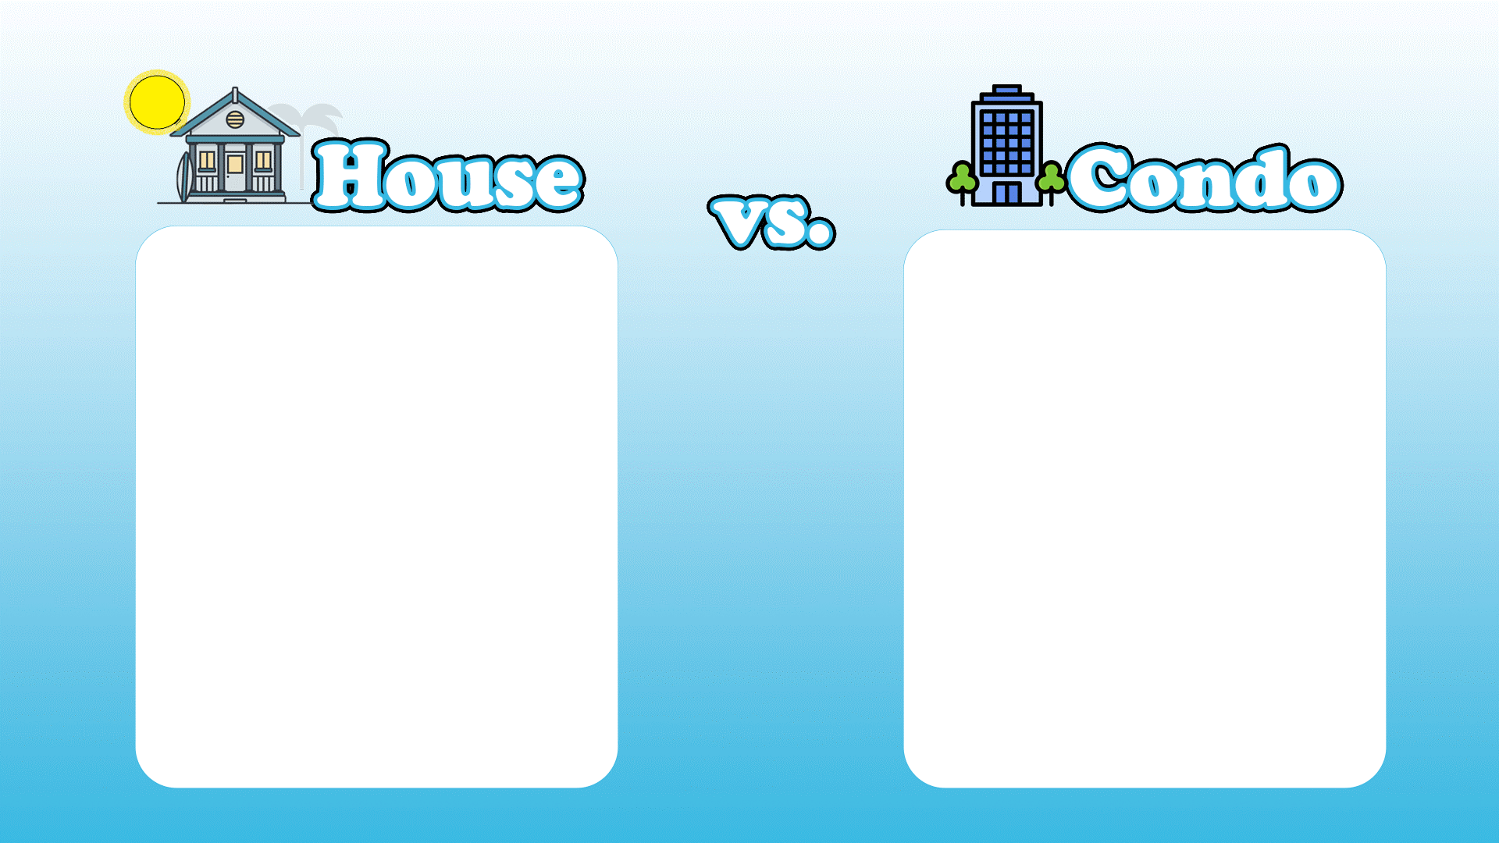
Greater avg nightly rent (avg $95 /night)
Lower avg nightly rent (avg $95 /night)
Still calculating expected home price
Still calculating expected condo price
DIY maintenance or hire
Maintenance often included in agreement

Slide 10
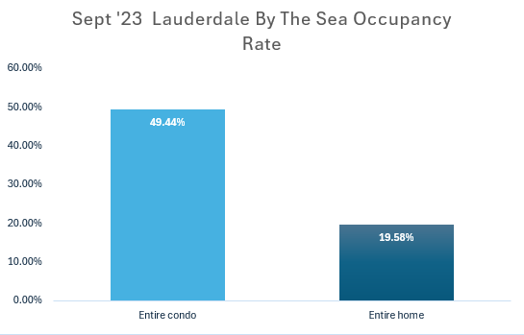
Occupancy rates based on 30 days acquired the dataset from the AirBnB Sept. Data Set.
Looking into specifically Entire Condo & Entire Home with 2 bedrooms.
Condos has the higher occupancy rate in September '23.
Notes:
Upon further analysis grabbed from the Air Bnb data set. Looking at the 30 days availability Vs occupancy.
Condos with 2 bedrooms has shown to have a higher occupancy rate in September '23 compared to entire homes with 2 bedrooms.
This percentages maybe me high due to listings that has opted out of their availability
High Occupancy means better overall revenue.

Slide 11
 | Nightly Rate ($) | Occupancy Rate (%) | Days to Rent / Year | Projected Annual Revenue ($)
2 Br Home | $257 | 19% | 336 | $16,406.88
2 Br Condo | $161 | 49% | 336 | $26,507.04
Revenue generated from a 2 Bedroom Condo would cover ~ 45% of cost of ownership
Revenue generated from a 2 Bedroom Home would cover ~ 28% of cost of ownership
Notes:
This is a rough calculation of the projected revenue for both property types:

Slide 12
Work in Progress
Analysis of amenities relationship to occupancy rate.
Strong relationship between number of amenities and occupancy rate?
Strong relationship between certain types of amenities and occupancy rate?
Acquiring further privilege on free data for market research.

Slide 13
Variables & Assumptions
-Downpayment. We assumed 15% of net income x 2 sisters x 2 years equating to 9.3% of target property value.
-Interest rate: 7.7%
-Term of mortgage: 30 year fixed
-Property taxes specific to Lauderdale By The Sea, FL: (avg 1.52%)
-Credit Score. We assumed yours was >760 earning you a PMI of 0.5%
-Homeowner's Insurance: ranges from $800 to $2,500/year in Lauderdale By The Sea. Assumed $2,000 near beach.
-Monthly HOA: Likely needed in this area for home or condo. A community with comparable listing prices cited HOA fee of $430/month
-Timing of your stay. If you spend your 4 weeks there in the off-season you'd benefit from revenue greater than our estimate.
-Our housing market price analysis likely errs on the high side as it draws from a neighboring market.
-Our occupancy percentages are higher than their true value because of host black out dates. But they are forward looking. Historical would have been ideal.
Other factors
-AirBnB's Fee (~3% of gross)
-Housekeeping (make guest pay?)
-Utilities
-Municipal short term rental fee: Lauderdale By The Sea charges $500/year to hosts.

Slide 14


Slide 15
Research and Resources

Slide 17
Additional Considerations

